Slide 1
A Message from the AMCO SIG
Winter Newsletter | November 2023
Hi Everyone,
It was such a great time seeing everyone in New Orleans this year, we hope you feel energized and had a productive meeting! Here is a summary of our events in case you missed it. Looking forward to our upcoming webinar in January and please get your submissions ready for next year’s symposium, due January 15, 2024.
Warm regards,
Thomas Stokkermans, OD, PhD, FAAO, Chair
Case Western Reserve University
Derek Louie, MSc, OD, FAAO, Vice Chair
Oregon Health & Science University
Steven C. Quan, OD, FAAO, Communications Chair
University of Chicago
Bryce St. Clair, OD, FAAO, Membership Chair
John Hopkins Medicine
Sherry H. Day, OD, FAAO, Immediate Past Chair
University of Michigan

Slide 2
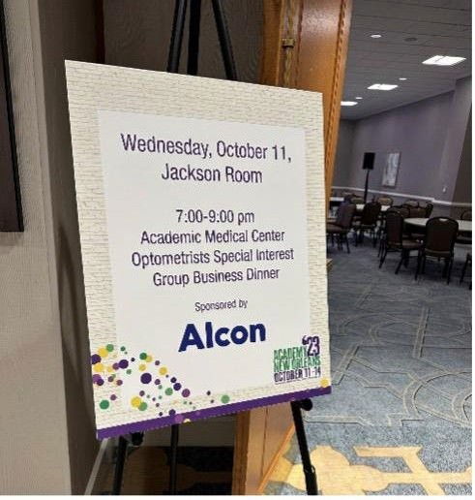
AMCO SIG Symposium: From the Trenches: Complex Cases from Academic Medical Centers
We would like to thank our wonderful speakers (Drs. James Hill, Thomas Urosevich, and Robert Bittner) and panelists (Drs. Collin Kane, Molly Marra, and Dan Gombos) for their presentations and clinical acumen. The discussion was engaging and gave us valuable insight for effective co-management with specialists in neuro-ophthalmology, genetic counseling, and oncology!
Calling for Abstracts for 2024!
We are now accepting abstracts for next year’s AMCO SIG symposium. The Academy 2024 Indianapolis will be held from November 6-9, 2024. Instructions to submit abstracts are linked below. Please send case reports directly to Dr. Thomas Stokkermans at thomas.stokkermans@uhhospitals.org by January 15, 2024.
View Instructions for Submission
AMCO SIG Business Dinner
Special thanks to Alcon for helping us host our annual business dinner at the Hilton and inviting new members to the group! We shared updates on our strategic plan and
reviewed data from our publication in the April 2023 issue of Optometry and Visual Science (OVS). We are excited to continue this research and hope to expand our membership with a new outreach program, spearheaded by our newly formed Advisory Council.
AMCO SIG Winter Newsletter | November 2023

Slide 3
Advisory Council
Join us in congratulating the members of our first Advisory Council, who were officially announced at the 2023 Business Meeting!
Kaleb Abbott, OD, MS, FAAO (University of Colorado) Amanda Crum, OD, MS, FAAO (Johns Hopkins University) Barbara Crutchfield, OD, FAAO (University of Kentucky) James Hoekel, OD, FAAO (Washington University in St. Louis) Andrew Ritter, OD, FAAO (University of Minnesota)
Suzanne Sherman, OD, FAAO (University of South Florida)
Evan Kaufman, OD, FAAO (University of Virginia)
The purpose of the Advisory Council is to support talented leaders in our organization and improve the quality and scope of programs for our members. The first task of the Advisory Council is to create a network of local ambassadors who can expand our membership and promote the SIG to optometrists at every academic medical center in the country. If you or someone you know would be interested in serving as an ambassador for your state or region, please let us know!
Webinar
Our next webinar will be a discussion on negotiating your position at AMCs. We will start with general guidelines to assess your role in the department and how to get more support or resources. We will then ask for members to offer practical advice on how they navigated the process at different institutions. If you have any ideas or resources you’d like to present, please let us know so we can add them to agenda.
RSVP HERE!
How to Negotiate Your Position at an Academic Medical Center
Date: Wednesday, January 17, 2024
Time: 8:30 – 9:30 PM EST
Location: Virtual (zoom link provided with registration)
If you have any questions or requests, please contact Dr. Steven Quan at scquan@bsd.uchicago.edu.
AMCO SIG Winter Newsletter | November 2023

Slide 4
Career Opportunities
Our members have shared the following active job postings for optometrists at ophthalmology departments across the country. Follow the links to learn more about each faculty position and how to apply.
Case Western Reserve University (Cleveland, OH) - Full-time Medical Optometrist
Full-time Medical Optometrist at University Hospitals Cleveland Medical Center and Case Western Reserve School of Medicine in Cleveland, Ohio. Residency training is preferred.
Please contact Thomas Stokkermans, OD, PhD, FAAO, at thomas.stokkermans@uhhospitals.org
Johns Hopkins University (Baltimore, MD) – Vision Rehabilitation
Medical College of Wisconsin (Milwaukee, WI) - Comprehensive Care
Oregon Health & Science University (Hood River, OR) - Primary Care, Contact Lenses
University of Michigan (Ann Arbor, MI) - Pediatric Optometry
Virginia Commonwealth University Medical Center (Richmond, VA) – Ocular Disease, Contact Lenses
Website
We know many of you are not receiving our emails through the Academy listserv, as the SIGs and Sections community websites are still being renovated by the AAO. We are creating a separate email list to ensure communications reach you. Remember to check your spam/junk folders for AAO announcements, as many academic institutions have strong privacy filters! Also, if you haven’t already, please update your profile settings to include the AMCO SIG as one of the selected special interest groups.
We are working with the Academy to create a platform on the AMCO SIG page so our members can interact and share resources with each other.
For now, if you want to share news or career opportunities with our members, please use the contact form on the SIG website or contact the current Communications Chair, Dr.
Steven Quan, at scquan@bsd.uchicago.edu.
STAY CONNECTED
American Academy of Optometry | 925 S Semoran Blvd, Suite 120, Winter Park, FL 32792
AMCO SIG Winter Newsletter | November 2023

